Slide 1

Final Year Project (CS-491) Proposal
Fall ’21, BS(CS)
“CodeClassy”
Team Candidates
Saif Ul Islam - 18K 0307
Muhammad Hassan Zahid - 18K 0208
Tashik Moin Sheikh - 18K 0142
Supervisor
Muhammad Rafi (muhammad.rafi@nu.edu.pk)
Dated
Sept ‘21

Slide 2
Abstract
A product aiming to provide a flexible, heavily featured, organized, easy-to-use, and integrated system to counter many challenges found in EdTech
Modernizing education needs software that’s matched with a/an (a) ease of use, (b) unified platform, (c) feedback system, (d) collaborative model
Tackling online vs hybrid challenges
Resulting MVP platform orchestrating a submission, review, and feedback process through base functionalities

Slide 3

EdTech
Refers to the domain of creating educational software/technology for a better educated tomorrow

Slide 4
Focus On Major EdTech Problems
Tackling problems such as ...
Technicality Overhead - software being used for education not designed for remote education in the first place leads to obvious technical difficulty and overhead
More Than MOOCs - concentrating on collaboration, feedback & review system above certifications
Instructor Training - instructors lack knowledge to make best use of the software they use. We intend to make the process painless by working on “ease-of-use” and “ease-in-adoption”.

Slide 5
Introduction 🔭
Initial Motivation 🔥
CodeClassy vs “Others” 🌱
Traditional Education Inconveniences 💡
What We Have To Consider 💭
Where did the idea come from? 📝

Slide 6
Our Idea Of A Platform 🤔
It should be ...
Easy to use
Popular obstacles and issues
Integration & Interoperability
Cost & time effectiveness
To be as efficient as possible 💯
Because traditional methods have ...
Inflexible scheduling
Temporary information
Hard to track progress
Time constraints
Collaborative learning limitations
All of which cost time ⏲️

Slide 7
What We Have In Mind
(Our Approach)
💻 + 🧠 = ✔️
To build such a platform …
We want to follow a proper SDLC that does the following,
Requirement Analysis
Software Designing
Software Development / Implementation
Software Architecture
Software Management

Slide 8
Project Overview 🔭
Problem Description
Background Motivation
Project Significance
How have we recognized the problem and what does it mean to us? 🧑‍💼

Slide 9
How CodeClassy is Different
Some background ...
Platforms have only one core feature (GCR, HackerRank etc)
Hesitancy in adoption rates
Inflexible, not catering to educational process requirements
Overall, coerced adoption, not really personalized tooling
Our Solution ...
Collaborative assessments
Ease of use & content organization
Integration & interoperability between features
Focused progress tracking
Collaboration is an essential aspect that many popularly current tools lack

Slide 10




CodeClassy vs “Others”
 | Quiz System | Remote Code Execution | Real Time Code Collaboration | Coding Assignments | Classrooms | Formative/ Summative Assessments | Sub Groups / Grouping | Code Bank
Repl | ❌ | ✔️ | ✔️ | ❌ | ❌ | ❌ | ✔️ | ❌
Hacker Rank | ❌ | ✔️ | ❌ | ❌ | ❌ | ❌ | ❌ | ❌
Google Classroom | ❌ | ❌ | ❌ | ✔️ | ✔️ | ❌ | ❌ | ❌
Class Marker | ✔️ | ❌ | ❌ | ❌ | ❌ | ✔️ | ✔️ | ❌
CodeClassy | ✔️ | ✔️ | ✔️ | ✔️ | ✔️ | ✔️ | ✔️ | ✔️

Slide 11
Why Is This Solution Important?
Globally needed solution awaits ...
The project stands its ground significance in the problem it tackles,
Challenging, unique features ⚙️
No niche SaaS that deals with feature integration as ours 🔗
Huge EdTech boom in 5-6 years 💥

Slide 12
Methodology 👨‍💻
Requirement Analysis
Software Design Principles
Tracking Progress
Implementation
Testing
Evaluation
What is our approach to solve the problem?

Slide 13
Requirement Analysis 🔬
An improper, incomplete, half-effort “Requirement Analysis” leads to a rough and “hard-to-maintain” product.
Thus, we wish to pass our project through complete processes of,
Core Feature Selection
Data Modelling
User Stories
View Development

Slide 14
“Software Design Principles” As Essentials 🔣
Before we implement …
Some imperative design principles we wish to implement,
Visit existing solutions - and builds what they lack, while also learning from their experience
Derive user workflow - how does a user get things done? We want to make the process intuitive
Use DRY - rapid development, reusing tested industry solutions
And more!

Slide 15
Tracking Progress 📈
Scrum Based - Accordingly with schedule, we look forward to using “Scrum”
Using Kanban as inevitable - modularity, task designation, and code ownership leads to lightning development
Tools as,
Notion - Personal informal team documentation
GitHub - Actions + Marketplace + Wiki + Issues + Pull Request + Security Alerts

Slide 16
Finally, Code 🤖
As per code implementation …
The following core requirements to build on top off,
Quizzes - (A) Question Creation, (B) Combining Results, (C) Exporting Results, (D) Handling Multiple Question Types, (E) Tracking ”Groups” Of Students
Remote Code Execution - (A) Programming In Browser, (B) Code Submissions, (C) Being Assigned Coding Assessments, (D) Getting Code Output
Code Bank - A collection of questions that can be imported into assignments for RCE
Classrooms - grouping of students that will be able to view a stream of information/announcements
Formative/Summative Assessments - variations in the questions/tests helping in analyzing student performance
As per SDLC cycle, this includes, (A) Module Decomposition, (B) Implementing, (C) Testing, (D) Evaluating

Slide 17
Tests & Evaluation
🎼
Regarding TDD ...
Intended, but not promised
Lack of time, documentation focus maybe deterrent factors
Suggested as best practices - to be tested if fits timeline
Manual Evaluation ...
Varying from module to module
In accordance with SOLID

Slide 18
Features 📋
Requirements,
Quiz Management Framework
Remote Code Execution
Code Bank
Formative/Summative Assessments
Classrooms
Evaluation & Marking
Cumulative Formative & Submissive Assessments
User Stories,
Quiz Management Framework
Remote Code Execution
Code Bank
Formative/Summative Assessments
Classrooms
Remote Code Execution
Evaluation & Marking
What are the main requirements we would like to implement?

Slide 19
Overview of requirements
Quiz Management Framework!
Data Models such as “question bank”, “QML”, “Tests”, “Test”, “Question”, “Answer”, “Group(s)”
Time limits, filters, markings, individual to group results, adding/removing students, etc
Remote Code Execution!
Running, submitting, and evaluating code results in the browser
Boiler-plate, code bank via TuringsCraft (expected), test cases, varying languages (minimally C/C++)
And more about Code Bank, Classrooms, Formative/Summative assessments

Slide 20
Feasibility, Risk Analysis, & Fallback Plan 📅
Business & Market Prospects
Costs & Risks
What are some inherent risks within the project and what are the business prospects to consider those risks?

Slide 21
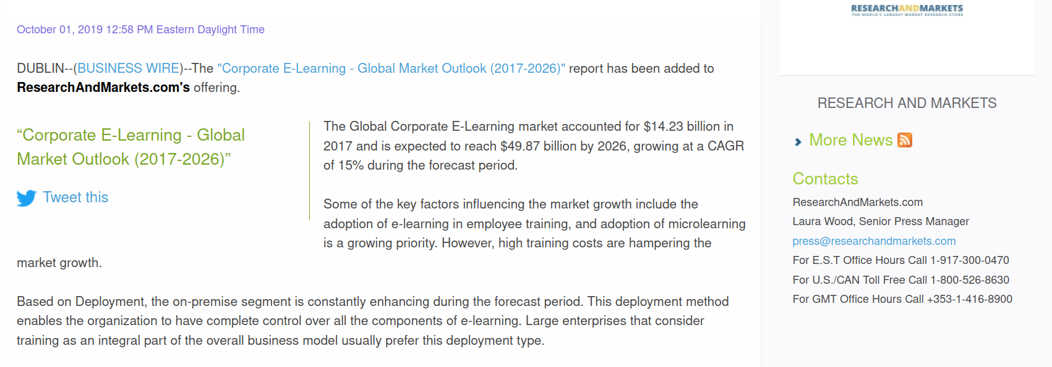
Business & Market Prospects

Slide 22
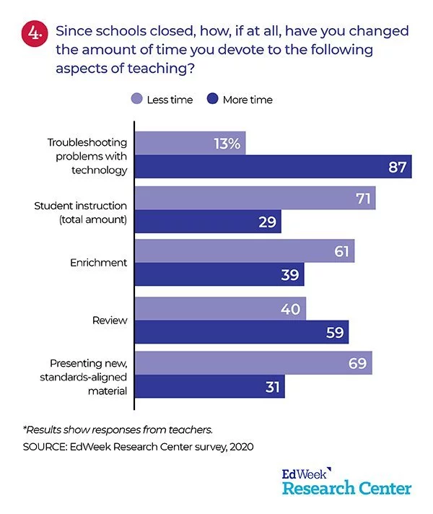
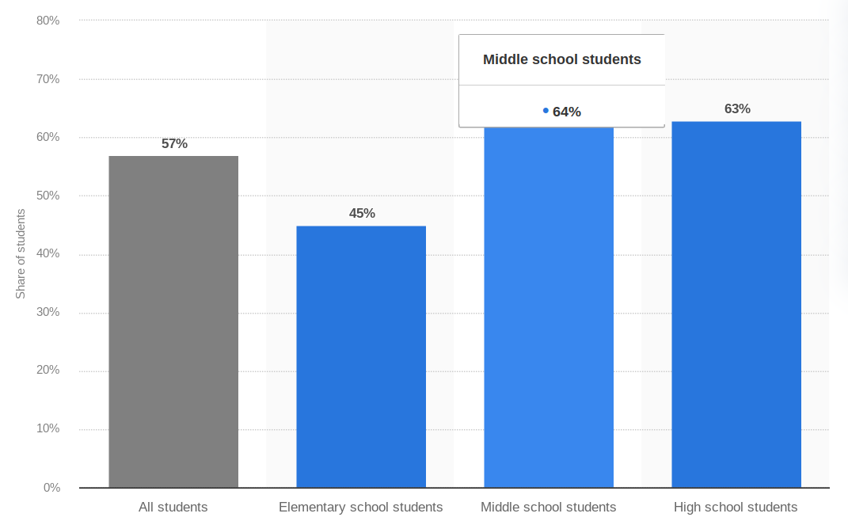
Market Needs Adaptation
Share of K-12 students in the United States who use digital learning tools daily in 2019, by school level

Slide 23
Costs & Risks
Talking about Hardware & Software costs ...
Software - Open Source Software! 0% costs
Project Management - Freely available tools for workflow management
Hardware - Tricky, we need infrastructure to develop the “Remote Code Execution” requirement
Risks - deadline constraints, limiting scope, MVP

Slide 24
Deliverable Project
FYP I
FYP II
What do we plan to deliver in the project?

Slide 25
FYP I
Includes,
Requirement Analysis
Design Phase
Data Modelling
Architecture & Infrastructure setup
Implementation Phase (WIP) & Boiler Plate setup
Quiz Replacement

Slide 26
FYP II
Includes,
Finalizing “Remote Code Execution”
Finishing FYP touches
Generating FYP report

Slide 27
Schedule 📅

Slide 28
Requirement Analysis starts
Project proposal submission,FYP I defense
FYP Demo
August ‘21
Sept ‘21
Oct ‘21
Nov ‘21
Dec ‘21
Dec ‘21
Finalizing design phase, moving towards implementation
Implementation continued, Mid II approaches
SRS/SDS submission, Finals, FYP I Deliverable

Slide 29
Overall Progress
Expected delivery
June ‘22
Recent progress
Requirement Analysis, Use Case Extraction, Data Modelling
Project Proposal, SRS/SDS Documentation progress
Obstacles
Data Modelling proves to be time intensive
Implementation concerns, research over use requirements/use cases

Slide 30
Next steps
Making improvements to Project Proposal + SRS
Writing both pieces of documentation has been an iterative process and we keep coming back to polish more aspects of them
Finalizing Data Modelling
Finally generating a schema of entities within the system, and generating relations in the database
Prototyping
Converting design decisions into implementation

Slide 31
Thank you!
🎉 🎊 🥳
Key point summarization
Core idea revision
Feedback/suggestions as call to action - “what would you do if you were building this project?”
Q/A session

